Slide 1
Search Strategy Builder for Literature Reviews – UX Design
Ankie Fan
KE@work in UM library, 2022-2023

Slide 2
Content
Introduction
Research: Related Productions
Low-fidelity Prototyping

Slide 3
Introduction

Slide 4
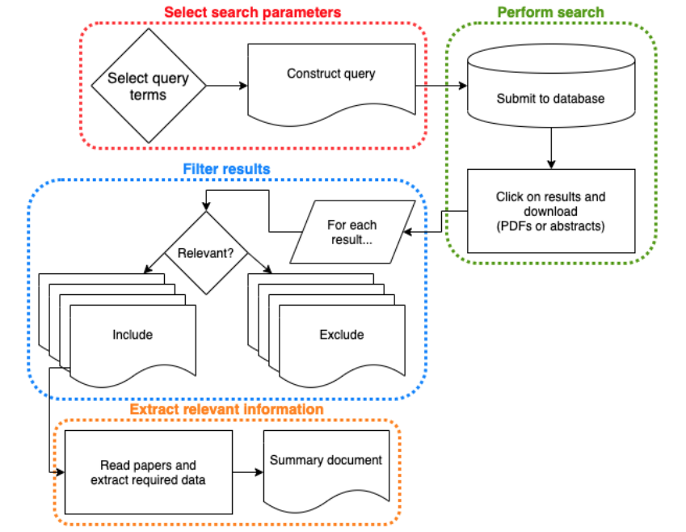
Literature Review
A piece of academic writing demonstrating knowledge and understanding of the academic literature on a specific topic placed in context.

Slide 5
An Example of Search Strategy (Query)
(exercise/exp OR kinesiotherapy/exp OR 'physical activity'/exp OR 'physical inactivity'/exp OR (exercise* OR ((fitness OR physical*) NEAR/3 (activ* OR inactiv* OR conditioning* OR exertion* OR workout OR work-out OR training)) OR sedentar* OR walking OR (muscle NEAR/3 training) OR kinesiotherap* OR kinesitherap* OR taichi OR tai-chi OR yoga OR strength-training OR cycling OR aerobics OR callisthenic*):ab,ti) AND ('job stress'/exp OR 'physiological stress'/de OR (((job OR work* OR occupation*) NEAR/6 (stress* OR strain* OR distress* OR fatigue)) OR burnout* OR burn-out* OR (compassion NEAR/3 fatigue)):ab,ti) AND ('health care personnel'/exp OR 'health personnel attitude'/exp OR (doctor* OR nurse* OR surgeon* OR physician* OR clinician* OR therapist* OR pharmacist* OR midwife* OR midwive* OR ((health* OR medical OR nursing OR surgery* OR psychiatr*) NEAR/3 (personnel* OR provider* OR worker* OR professional* OR resident* OR student* OR trainee*))):ab,ti)

Slide 6
What are we going to do:
Produce user search terms (keywords)
Provide a graphical interface for user to easily construct a search strategy
Figure 3

Slide 7
Related Productions

Slide 8
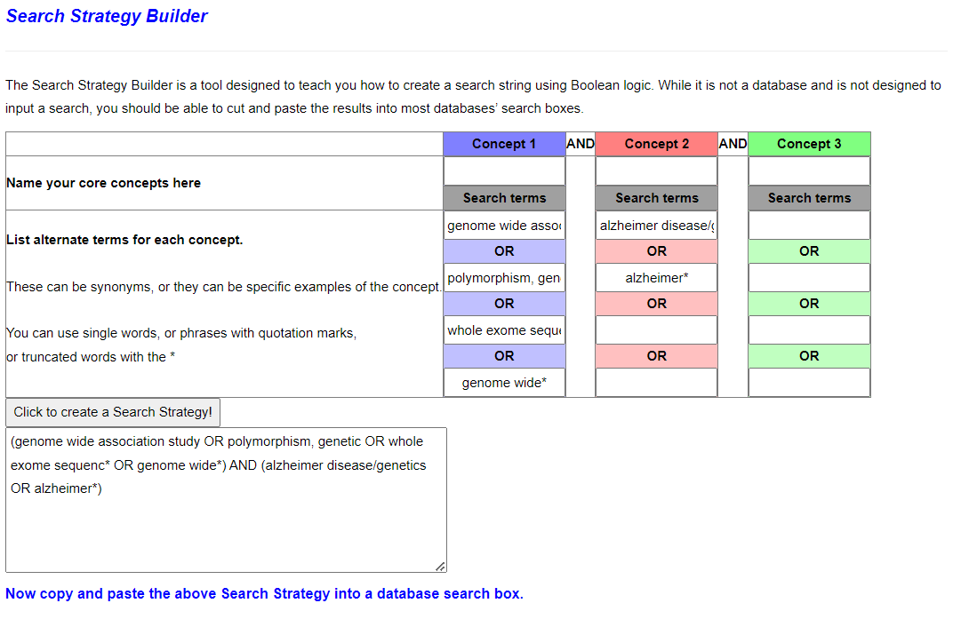
Normal Search Strategy Builder
Pros:
Clear instruction
Simple to use
Cons:
Single function
Old fasioned style

Slide 9
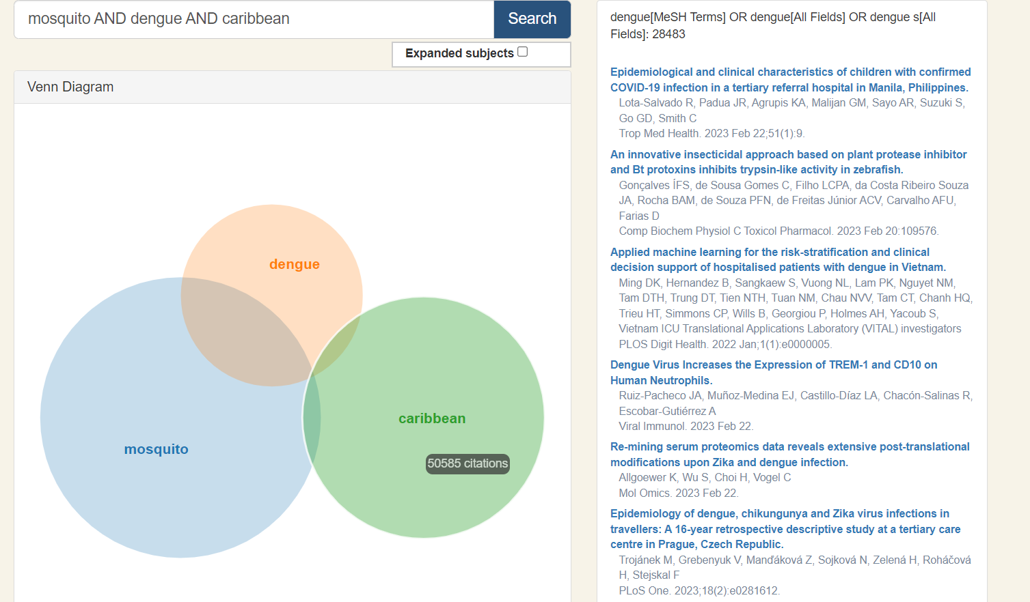
Pros:
Clear instruction
Simple to use
Nice visualization
Cons:
Single function

Slide 10
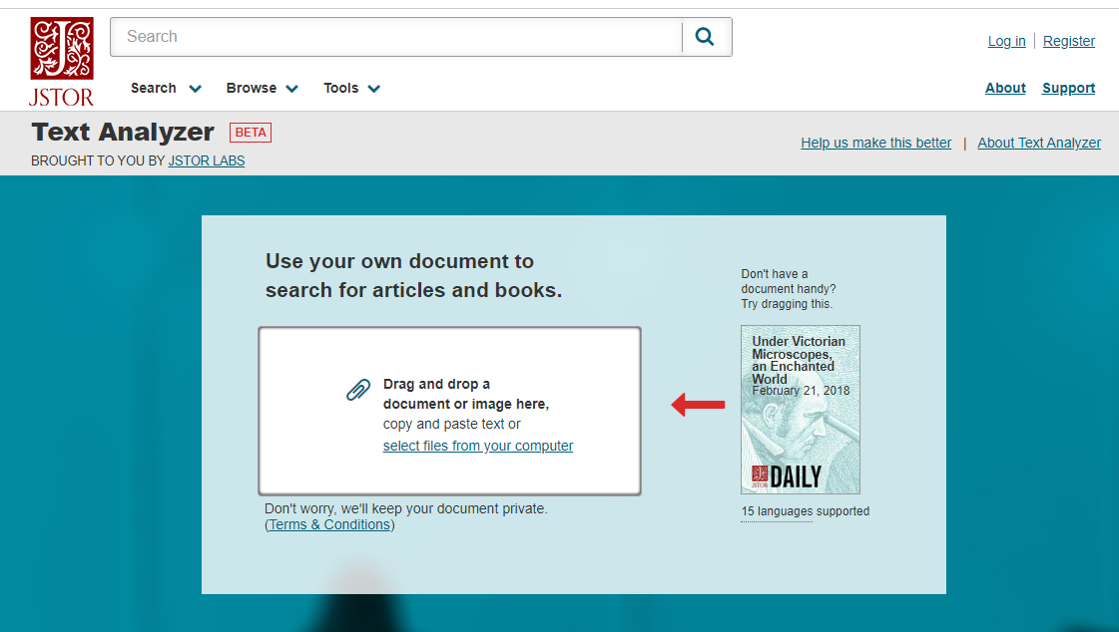
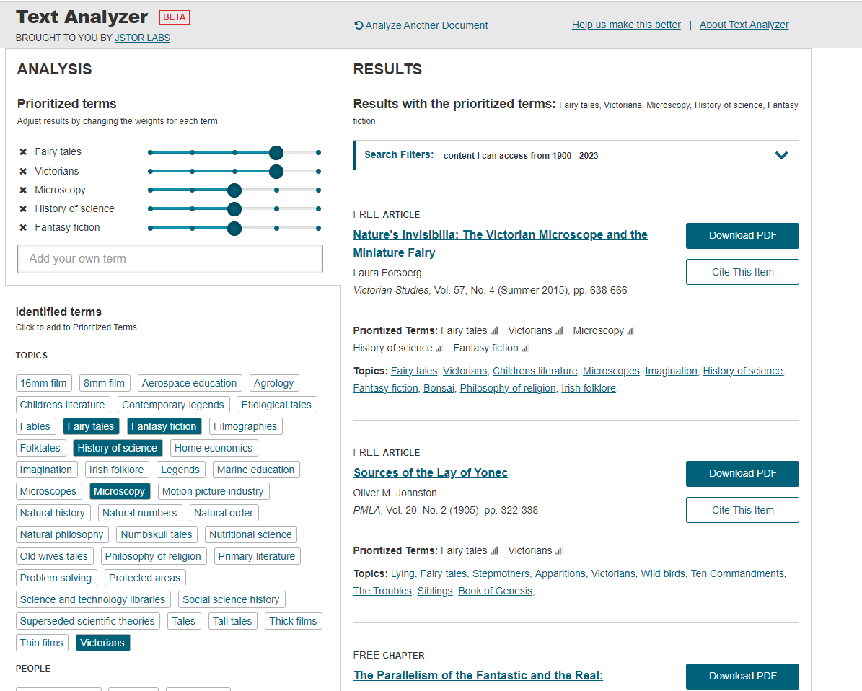
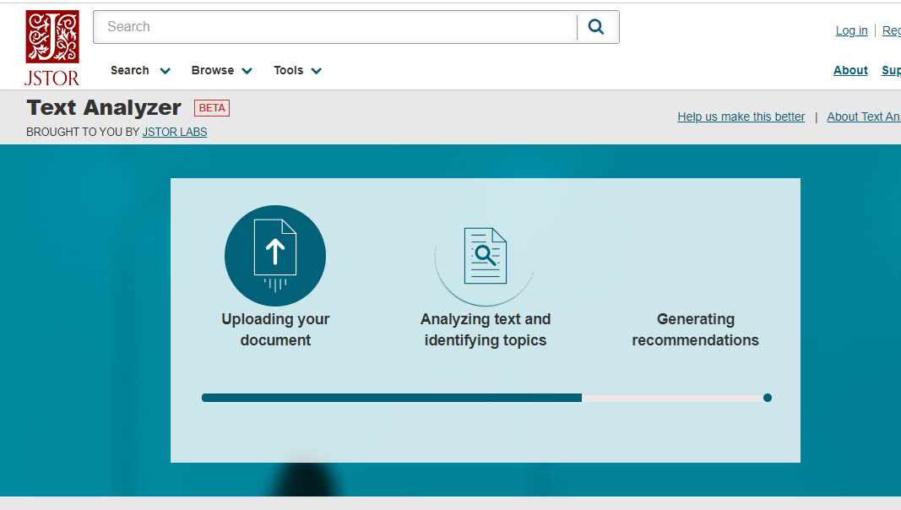
Topic Extraction Tool

Slide 11
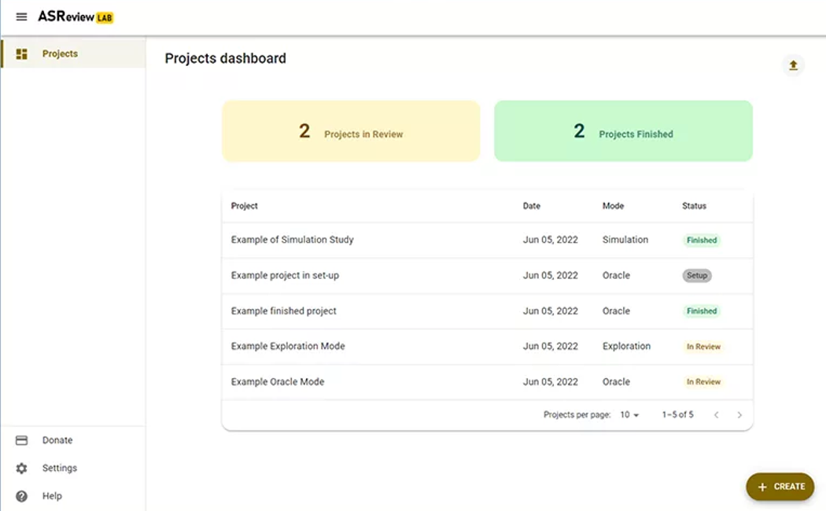
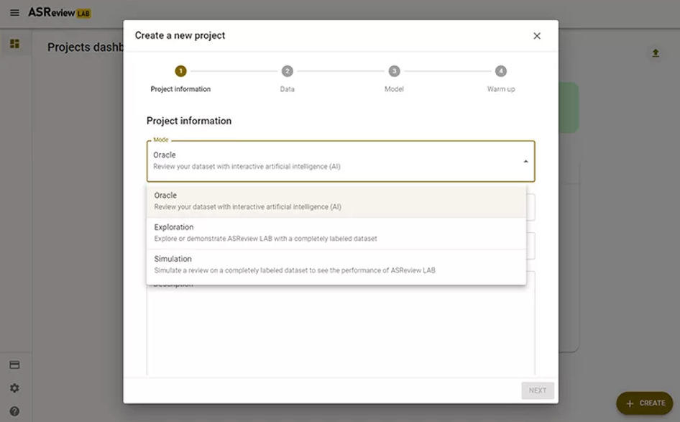
Screening Tool for Literature Review

Slide 12
Low-fidelity Prototyping

Slide 13
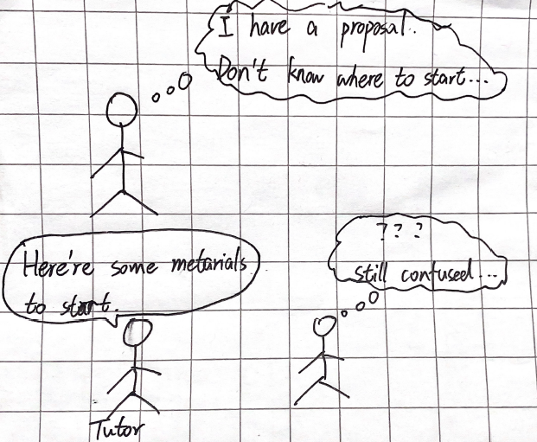
Low-fidelity Prototyping

Slide 14
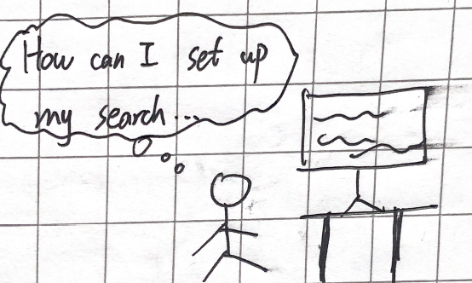








Low-fidelity Prototyping

Slide 15
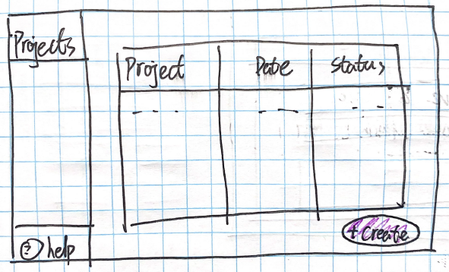

Low-fidelity Prototyping

Slide 16
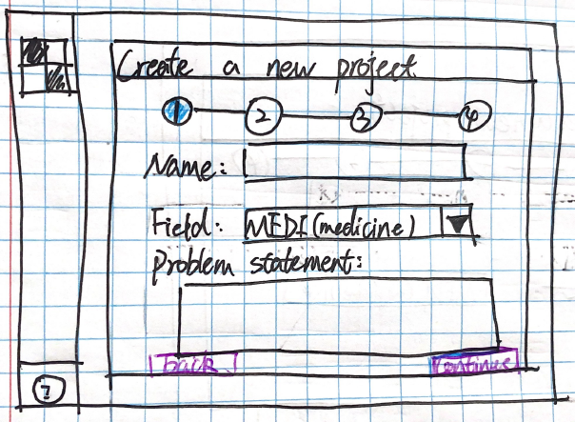
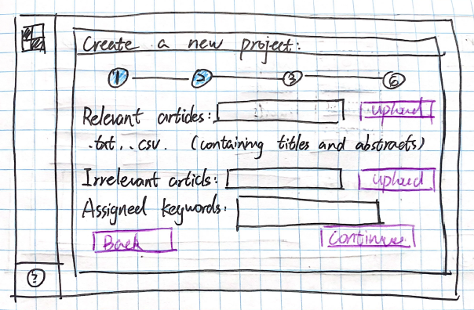
Low-fidelity Prototyping

Slide 17
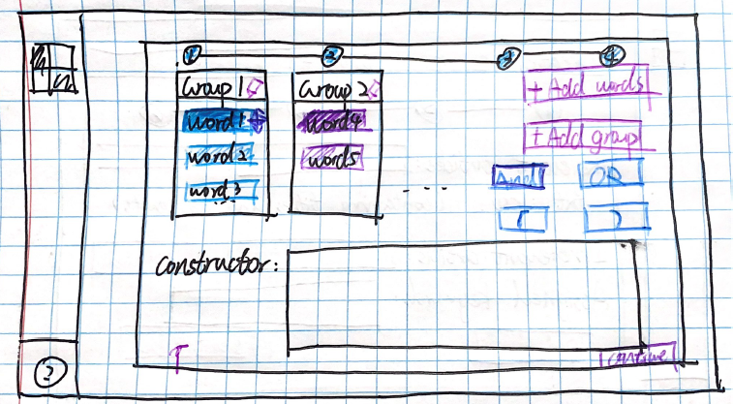
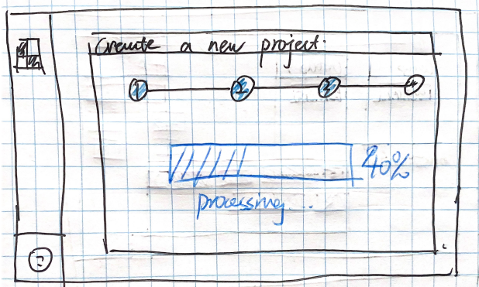
Low-fidelity Prototyping

Slide 18
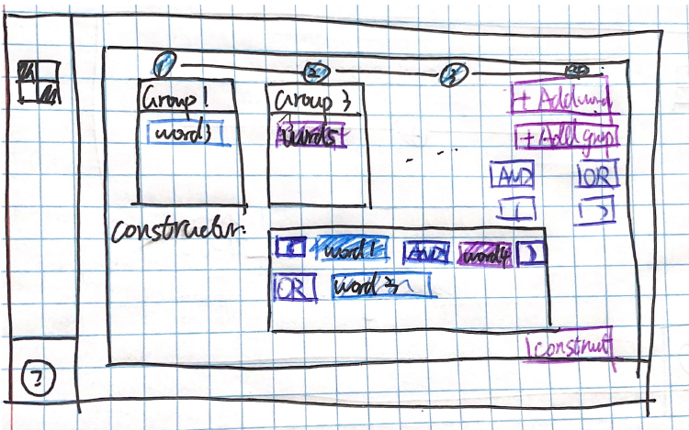
Low-fidelity Prototyping

Slide 19
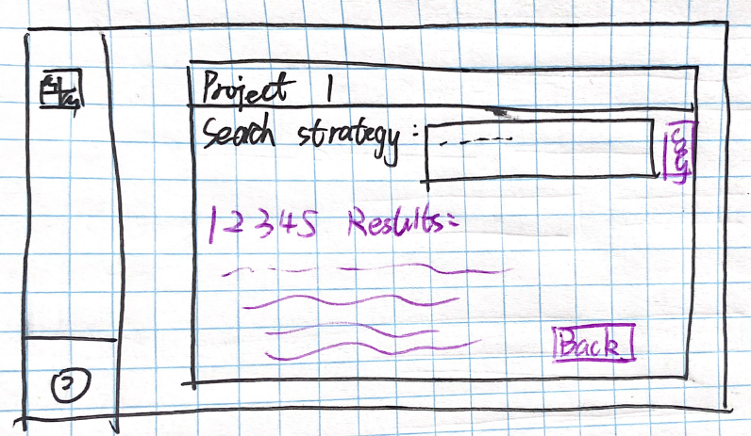
Low-fidelity Prototyping

